Slide 1


Wire Frame Model for 3D Automatic Wire Bending Machine
吴其兵

Slide 2
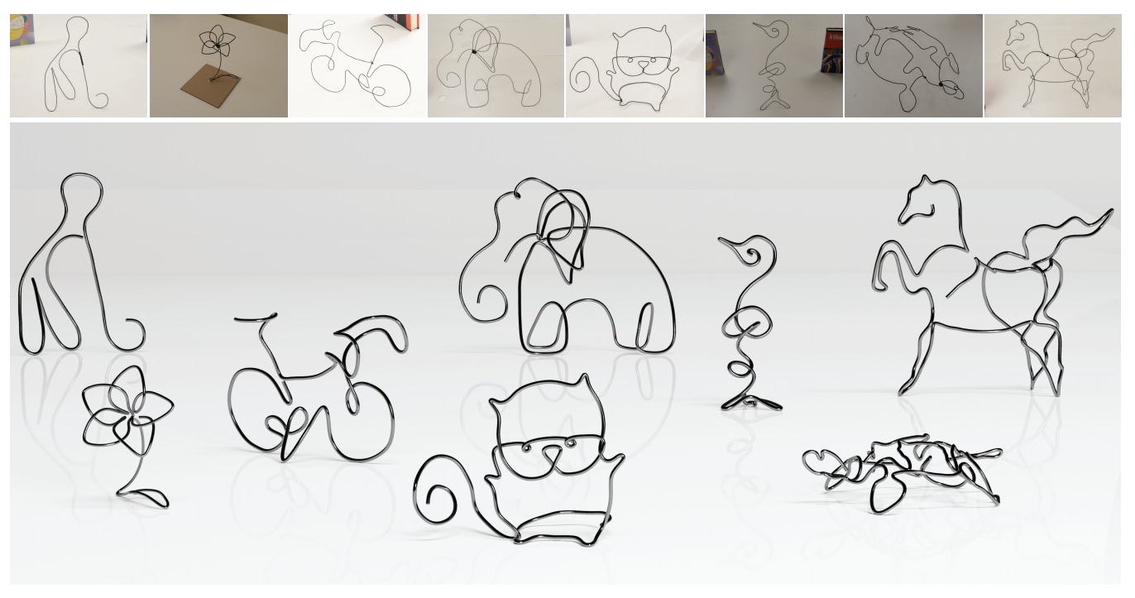
01
Inspiration of Project
Digitize and Reconstruct Wire Objects
Lingjie Liu, Duygu Ceylan, Cheng Lin, Wenping Wang, and Niloy J. Mitra. 2017. Image-based Reconstruction of Wire Art. ACM Trans. Graph. 36, 4, Article 63 (July 2017), 11 pages.

Slide 3
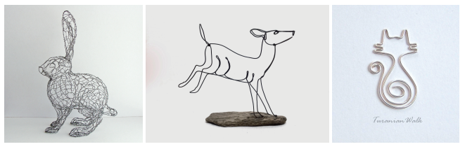
02
Introduction of Project
Wire is a kind of pseudo one dimensional material that gives a sense of drawing in three dimensions by bending and connecting wires.
Both the design and physical construction processes are time consuming and demand highly sophisticated skills.
Artists may use wires extensively to approximate the surface of a 3D model, or use wires moderately to abstractly depict 3D and 2D shapes.
The coupled problem of aesthetic shape approximation and physical constraints.

Slide 4
02
Introduction of Project
Input
Output
a 3D surface model without any wireframe specifications
best abstraction
a single and fabricable wire
Novelty:
Fabrication-aware wire-art design is not enough.
Fill the fabrication gap of continuously bending.
Challenge：
Provide the best abstraction of the input model.
The abstraction must be fabricable by wire bending machine.
Notes:
Wallace Lira, Chi-Wing Fu, and Hao Zhang. 2018. Fabricable Eulerian Wires for 3D Shape Abstraction. ACM Trans. Graph. 37, 6, Article 240 (November 2018), 13 pages. https://doi.org/10.1145/3272127.3275049

Slide 5
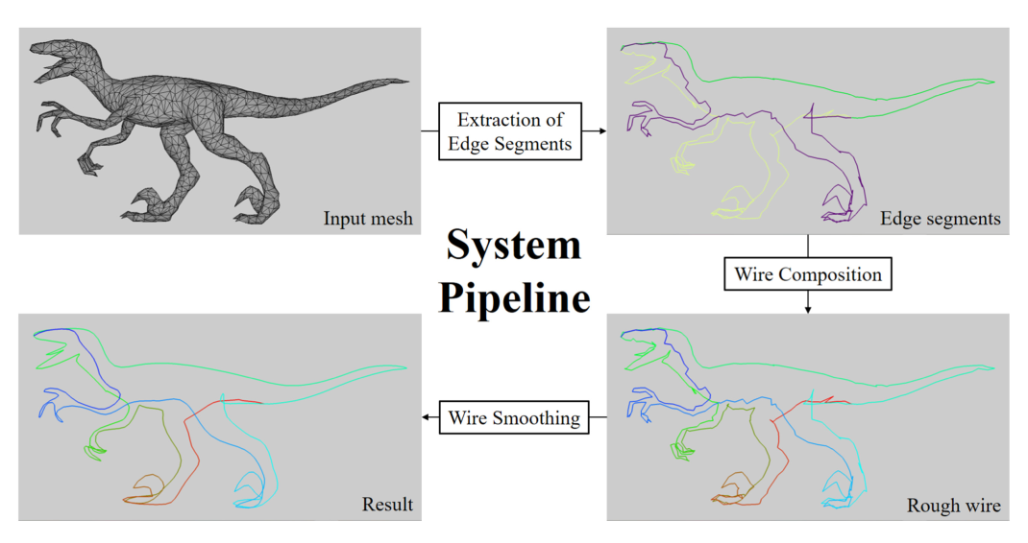
03
Wire Art Design
Create 3D Virtual Wire Sculptural Art from A Given 3D Model
The minimum number of wire lines
a greedy approach
mTSP
Chih-Kuo Yeh, Thi-Ngoc-Hanh Le, Zhi-Ying Hou, and Tong-Yee Lee. 2022. Generating Virtual Wire Sculptural Art from 3D Models. ACMTrans. Multimedia Comput. Commun. Appl. 18, 2, Article 51 (February 2022),23 pages.

Slide 6
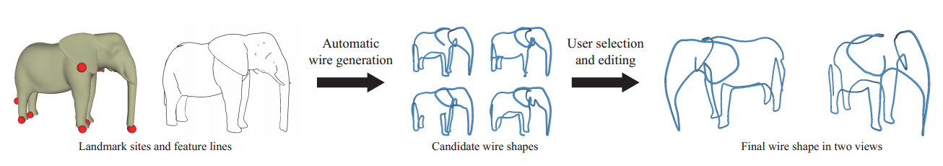
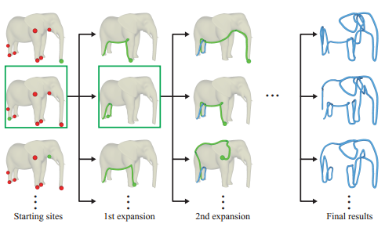
03
Wire Art Design
The Intelligent Design of Abstract 3D Wire Art with A Single-wire Structure
WireRoom framework
A dynamic travelling salesman problem on the surface of the 3D model with a multi-path expansion approach.
Explorative computational design procedure.
Zhijin Yang, Pengfei Xu, Hongbo Fu, and Hui Huang. 2021. WireRoom: Model-guided Explorative Design of Abstract Wire Art. ACMTrans. Graph. 40, 4,Article 128 (August 2021), 13 pages.

Slide 7
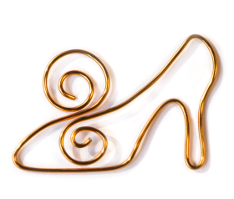
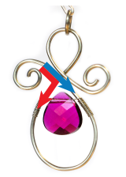
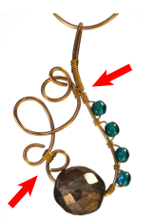
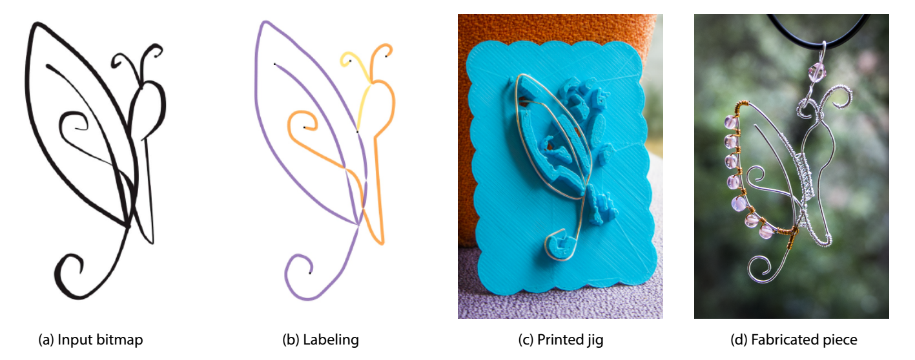
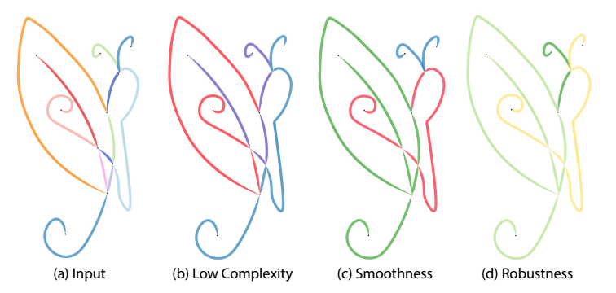
04
Wire Art Fabrication
Wire Decomposition and Assisting Wire Bending
Low complexity
Smoothness
Robustness
Customized Handmade Wire Wrapping Jewelry
An automatic wire decomposition algorithm
Generates a custom 3D-printed jig
Iarussi, E., Li, W., Bousseau, A. 2015. WrapIt: Computer-Assisted Crafting of Wire Wrapped Jewelry. ACM Trans. Graph. 34, 6, Article 221 (November 2015), 8 pages.

Slide 8
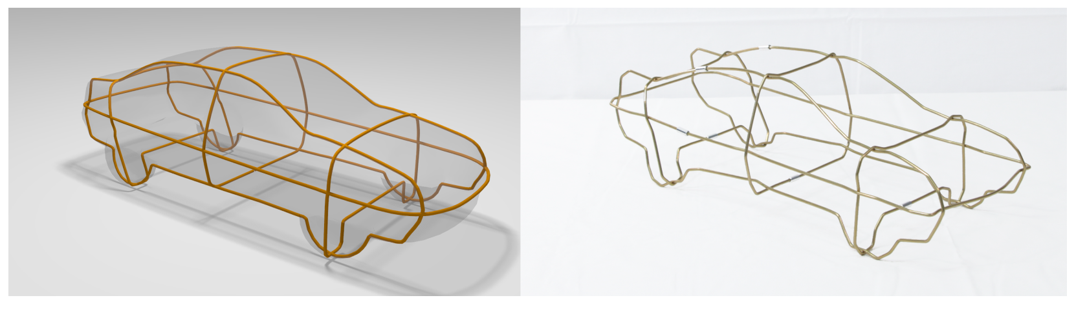
04
Wire Art Fabrication
Self-supporting Wire Sculptures
3D wire sculptures
Stable Planar-Rod Structures
2D wire bending machine
Assemble without the need of connectors between crossing wires
Finding an optimal set of wires to cover geometric features
Aesthetic shape approximation
Physical constraints
Finding a stable configuration
Miguel, E., Lepoutre, M., Bickel, B. 2016. Computational Design of Stable Planar-Rod Structures. ACM Trans. Graph. 35, 4, Article 86 (July 2016), 11 pages.

Slide 9
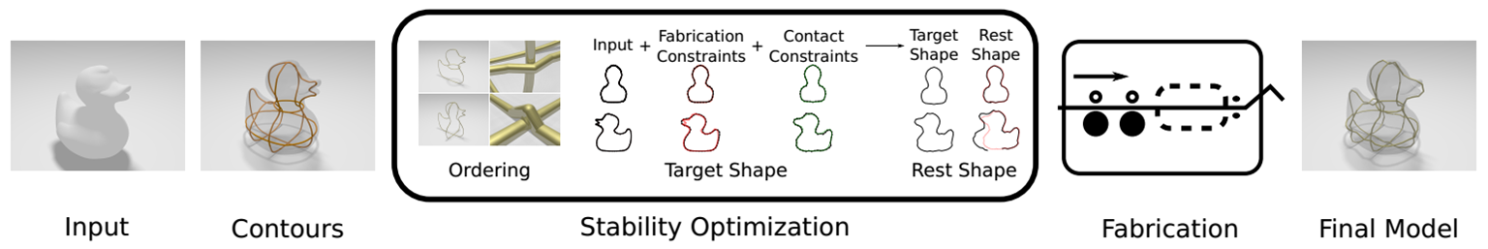
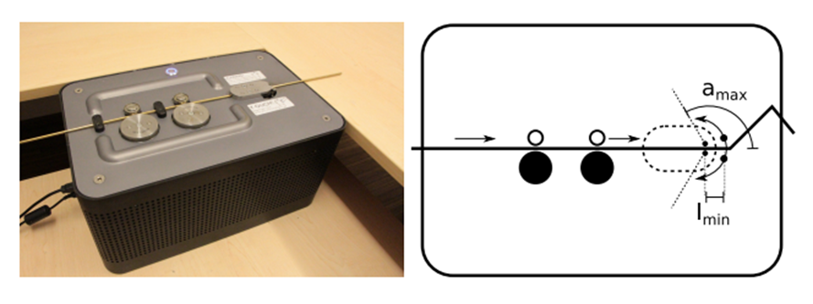
04
Wire Art Fabrication
Self-supporting Wire Sculptures
Stability Optimization
The Layering and Assembly Order
Target Shape Optimization
Rest Shape Optimization
Fabrication and Assembly
Wire Bending
Parameter Estimation
Miguel, E., Lepoutre, M., Bickel, B. 2016. Computational Design of Stable Planar-Rod Structures. ACM Trans. Graph. 35, 4, Article 86 (July 2016), 11 pages.

Slide 10
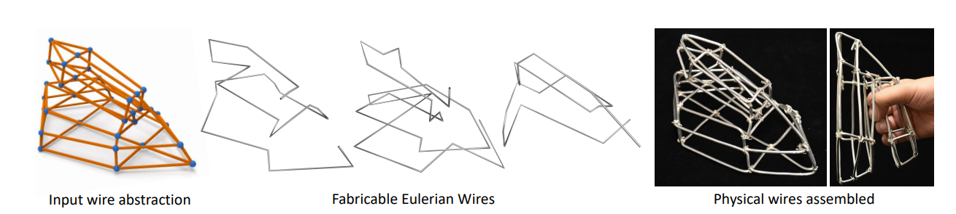
04
Wire Art Fabrication
Find Eulerian Wire Solutions with Few Wires and Small Overlap
Compute a small number of machine fabricable wires, called Eulerian wires, that reproduce a wire sculpture (left) with minimal overlap.
Non-planar wires, which can be fabricated by a wire bending machine.
Wire count minimization Overlap minimization Machine fabricability
Wallace Lira, Chi-Wing Fu, and Hao Zhang. 2018. Fabricable Eulerian Wires for 3D Shape Abstraction. ACM Trans. Graph. 37, 6, Article 240 (November 2018), 13 pages.

Slide 11
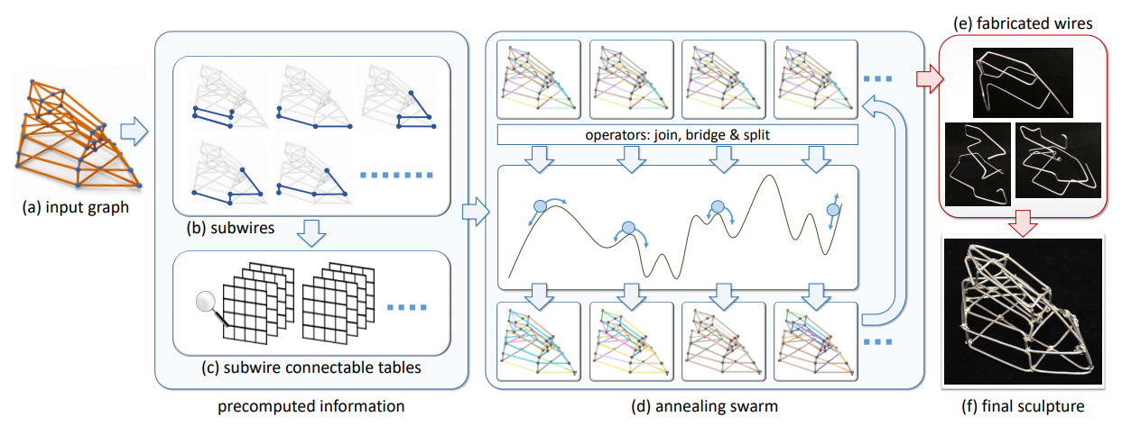
Wallace Lira, Chi-Wing Fu, and Hao Zhang. 2018. Fabricable Eulerian Wires for 3D Shape Abstraction. ACM Trans. Graph. 37, 6, Article 240 (November 2018), 13 pages.
04
Wire Art Fabrication
Find Eulerian Wire Solutions with Few Wires and Small Overlap
“Annealing Swarm” optimization model and the subwire mechanism.
A population-based hybrid metaheuristic model
The join, bridge and split operators.
An adaptive simulated annealing model

Slide 12
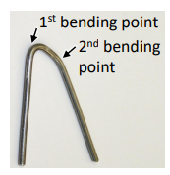
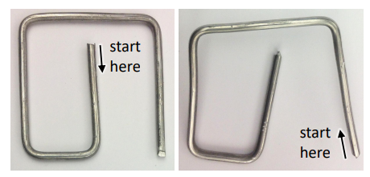
Wallace Lira, Chi-Wing Fu, and Hao Zhang. 2018. Fabricable Eulerian Wires for 3D Shape Abstraction. ACM Trans. Graph. 37, 6, Article 240 (November 2018), 13 pages.
04
Wire Art Fabrication
Below, rules for wire fabricability:
Rule 1: a wire is fabricable if it can be fabricated by the machine, starting from one of its two ends.
Rule 2: there are three cases for a fabricable wire: (i) forward fabricable, (ii) backward fabricable, and (iii) fabricable in both directions. Note that a wire fabricable from one of its ends may not be fabricable if we start its fabrication from the other end. See Figure 5 for an example; we can fabricate the wire from inside to outside, but not the other way around, due to wire-machine collision.
Rule 3: if a wire is fabricable in a certain direction, any sub-portion of the wire is also fabricable in the same direction. Conversely, if a wire is not fabricable in a certain direction, any longer wire that contains it is also not fabricable in the same direction.

Slide 13
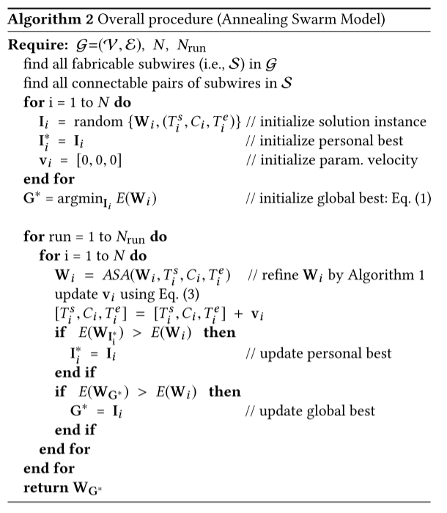
Wallace Lira, Chi-Wing Fu, and Hao Zhang. 2018. Fabricable Eulerian Wires for 3D Shape Abstraction. ACM Trans. Graph. 37, 6, Article 240 (November 2018), 13 pages.
04
Wire Art Fabrication

Slide 14
05
Future Work of Project
Search space is enormous
A single wire that covers the input is not always possible.
Avoid collisions during bending.

Slide 15
06
Wire Bending Machine
Fabrication Constraint
Avoid collisions during bending.
A mechanical limit in the bending angle (i.e., 120◦) that the machine supports .
Determine an appropri­ate bending sequence
Not causing self-collisions or col­lisions with the machine or the bending tool,
Not introducing deformations in the workpiece shape due to material elasticity,
Not generating too much vibrations, as they force to slow down the bending process.
Notes:
Andrea Baraldo, Luca Bascetta, Fabrizio Caprotti, Sumit Chourasiya, Gianni Ferretti, Angelo Ponti & Basak Sakcak (2022): Automatic computation of bending sequences for wire bending machines, International Journal of Computer Integrated Manufacturing, DOI: 10.1080/0951192X.2022.2043563

Slide 16
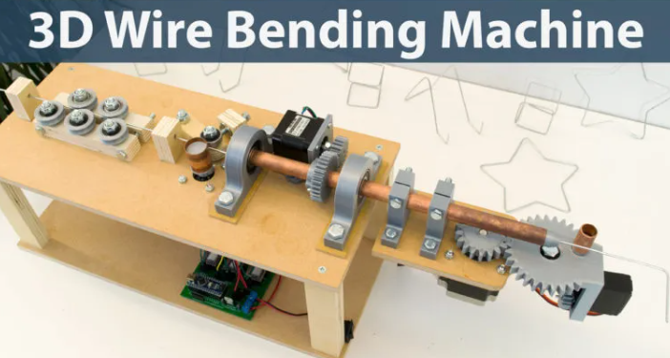
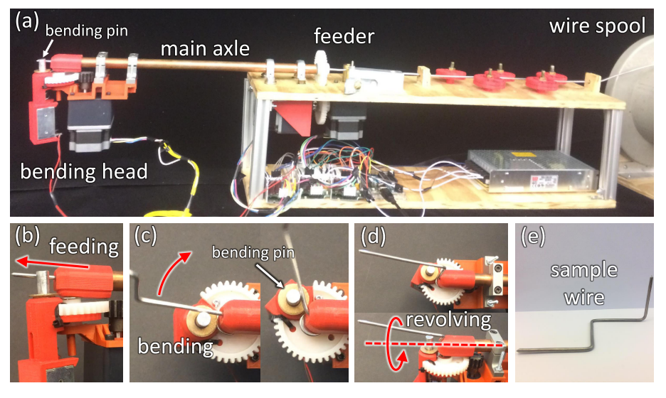
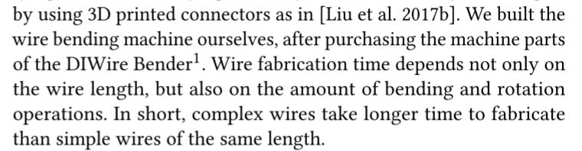
06
Wire Bending Machine
https://howtomechatronics.com/projects/arduino-3d-wire-bending-machine/
Notes:
Wallace Lira, Chi-Wing Fu, and Hao Zhang. 2018. Fabricable Eulerian Wires
for 3D Shape Abstraction. ACM Trans. Graph. 37, 6, Article 240 (Novem-
ber 2018), 13 pages. https://doi.org/10.1145/3272127.3275049

Slide 17
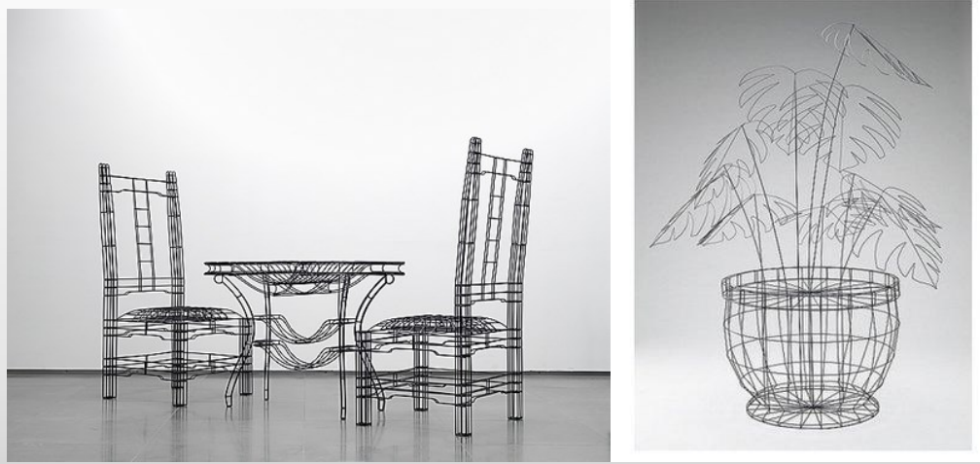
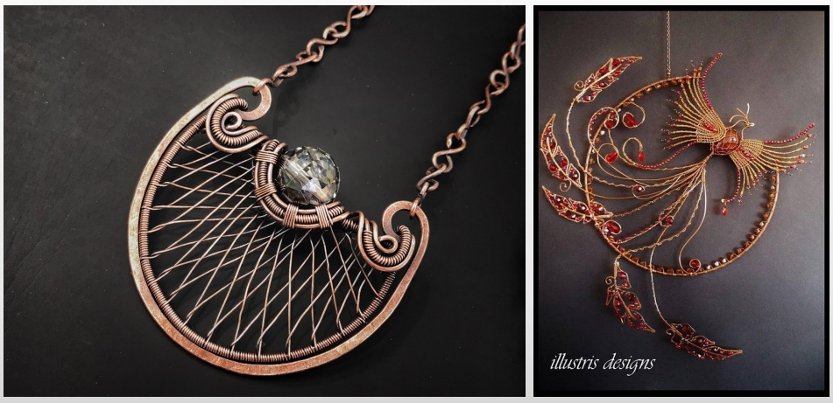
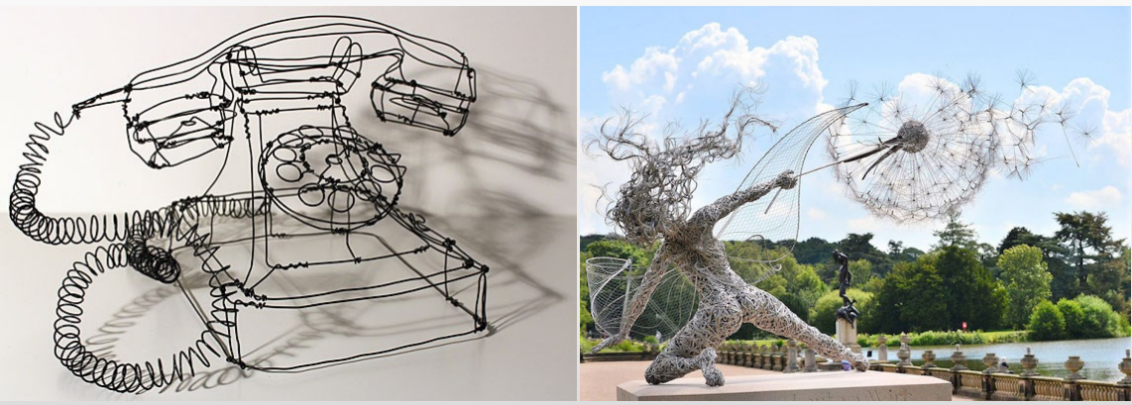
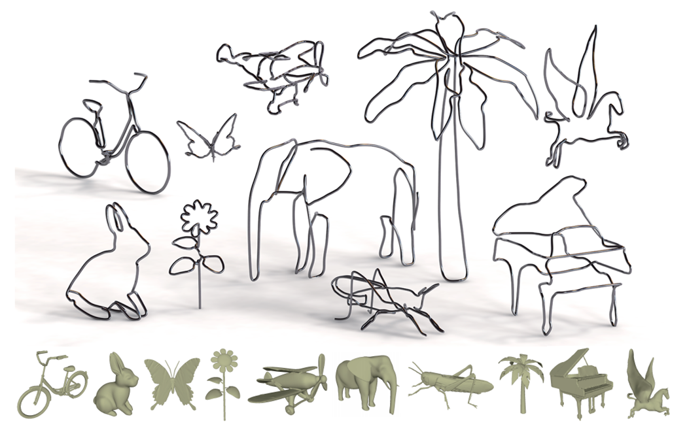
07
Application of Wire-based Product
Furniture design
Wire-wrapped jewelry
Wire sculpture art
Low-fidelity rapid prototyping
Notes:
Chih-Kuo Yeh, Thi-Ngoc-Hanh Le, Zhi-Ying Hou, and Tong-Yee Lee. 2022. Generating Virtual Wire Sculp-
tural Art from 3D Models. ACMTrans. Multimedia Comput. Commun. Appl. 18, 2, Article 51 (February 2022),
23 pages.
Zhijin Yang, Pengfei Xu, Hongbo Fu, and Hui Huang. 2021. WireRoom: Model-
guided Explorative Design of Abstract Wire Art. ACMTrans. Graph. 40, 4,
Article 128 (August 2021), 13 pages. https://doi.org/10.1145/3450626.3459796
Miguel, E., Lepoutre, M., Bickel, B. 2016. Computational Design of Stable Planar-Rod Structures. ACM Trans. Graph. 35, 4, Article 86 (July 2016), 11 pages. DOI = 10.1145/2897824.2925978 http://doi.acm.org/10.1145/2897824.2925978.

Slide 18
08
Reference
A

